Slide 1
Software Engineering BCA IV SEM
Software Design
Bijay Babu Regmi
bijay.regmi@deerwalk.edu.np

Slide 2
Design Concept
Software design is a mechanism to transform user requirements into some suitable form, which helps the programmer in software coding and implementation. It deals with representing the client's requirement, as described in SRS (Software Requirement Specification) document, into a form, i.e., easily implementable using programming language.
The software design phase is the first step in SDLC (Software Design Life Cycle), which moves the concentration from the problem domain to the solution domain. In software design, we consider the system to be a set of components or modules with clearly defined behaviors & boundaries.
Objectives of Software Design:
Correctness: Software design should be correct as per requirement.
Completeness: The design should have all components like data structures, modules, and external interfaces, etc.
Efficiency: Resources should be used efficiently by the program.
Flexibility: Able to modify on changing needs.
Consistency: There should not be any inconsistency in the design.
Maintainability: The design should be so simple so that it can be easily maintainable by other designers.

Slide 3
Continued….
Abstraction:
An abstraction is a tool that enables a designer to consider a component at an abstract level without bothering about the internal details of the implementation. Abstraction can be used for existing element as well as the component being designed.
Here, there are two common abstraction mechanisms:
- Functional Abstraction
- Data Abstraction
Functional Abstraction
- A module is specified by the method it performs.
- The details of the algorithm to accomplish the functions are not visible to the user of the function.
- Functional abstraction forms the basis for Function oriented design approaches.
Data Abstraction
- Details of the data elements are not visible to the users of data. Data Abstraction forms the basis for Object Oriented design approaches.

Slide 4
Continued….
Architecture:
Architectural design is the specification of the major components of a system, their responsibilities, properties, interfaces, and the relationships and interactions between them.
In architectural design, the overall structure of the system is chosen, but the internal details of major components are ignored.
At this level, the designers get the idea of proposed solution domain.
Issues in architectural design includes:
- Gross decomposition of the systems into major components.
- Allocation of functional responsibilities to components.
- Component Interfaces
- Component scaling and performance properties, resource consumption properties, reliability properties, and so forth.
- Communication and interaction between components

Slide 5
Continued….
Design Pattern:
A design pattern is a general repeatable solution to a commonly occurring problem in software design. A design pattern isn't a finished design that can be transformed directly into code. It is a description or template for how to solve a problem that can be used in many different situations.
In addition, patterns allow developers to communicate using well-known, well understood names for software interactions. Common design patterns can be improved over time, making them more robust than ad-hoc designs.
Creational Design Pattern:
These design patterns are all about class instantiation. This pattern can be further divided into class-creation patterns and object-creational patterns. While class-creation patterns use inheritance effectively in the instantiation process, object-creation patterns use delegation effectively to get the job done.
These design patterns provide a way to create objects while hiding the creation logic, rather than instantiating objects directly using new operator. This gives program more flexibility in deciding which objects need to be created for a given use case.

Slide 6
Continued….
Structural Design Patterns:
These design patterns are all about Class and Object composition. Structural class-creation patterns use inheritance to compose interfaces. Structural object-patterns define ways to compose objects to obtain new functionality.
Behavioral Design Patterns:
These design patterns are all about Class's objects communication. Behavioral patterns are those patterns that are most specifically concerned with communication between objects.

Slide 7
Continued....
Modularity
Modularity specifies to the division of software into separate modules which are differently named and addressed and are integrated later on in to obtain the completely functional software.
It is the only property that allows a program to be intellectually manageable. Single large programs are difficult to understand and read due to a large number of reference variables, control paths, global variables, etc.
The desirable properties of a modular system are:
- Each module is a well-defined system that can be used with other applications.
- Each module has single specified objectives.
- Modules can be separately compiled and saved in the library.
- Modules should be easier to use than to build.
- Modules are simpler from outside than inside.

Slide 8
Continued....
Advantages of Modularity:
It allows large programs to be written by several or different people
It simplifies the overlay procedure of loading a large program into main storage.
It provides more checkpoints to measure progress.
It provides a framework for complete testing, more accessible to test
It produced the well designed and more readable program.
Disadvantages of Modularity:
Execution time maybe, but not certainly, longer
Storage size perhaps, but is not certainly, increased
Compilation and loading time may be longer
Inter-module communication problems may be increased

Slide 9
Continued....
Cohesion
Cohesion is a measure that defines the degree of intra-dependability within elements of a module. The greater the cohesion, the better is the program design.
Several types of Cohesion are:
Co-incidental cohesion - It is unplanned and random cohesion, which might be the result of breaking the program into smaller modules for the sake of modularization. Because it is unplanned, it may serve confusion to the programmers and is generally not-accepted.
Logical cohesion - When logically categorized elements are put together into a module, it is called logical cohesion.
Temporal Cohesion - When elements of module are organized such that they are processed at a similar point in time, it is called temporal cohesion.
Procedural cohesion - When elements of module are grouped together, which are executed sequentially in order to perform a task, it is called procedural cohesion.
Communicational cohesion - When elements of module are grouped together, which are executed sequentially and work on same data (information), it is called communicational cohesion.

Slide 10
Continued....
Coupling
Coupling is a measure that defines the level of inter-dependability among modules of a program. It tells at what level the modules interfere and interact with each other. The lower the coupling, the better the program.
There are five types of coupling:
Content coupling - When a module can directly access or modify or refer to the content of another module, it is called content level coupling.
Common coupling - When multiple modules have read and write access to some global data, it is called common or global coupling.
Control coupling - Two modules are called control-coupled if one of them decides the function of the other module or changes its flow of execution.
Stamp coupling - When multiple modules share common data structure and work on different part of it, it is called stamp coupling.
Data coupling - Data coupling is when two modules interact with each other by means of passing data (as parameter). If a module passes data structure as parameter, then the receiving module should use all its components.

Slide 11
Information Hiding
Information or data is very crucial resource to us. Thus securing the information becomes all the more necessary. The communication media through which we send data does not provide data security, so other methods of securing data are required. Information hiding plays a very crucial role today.
It provided methods for encrypting the information so that it becomes unreadable for any unintended user. This paper reviews the techniques that exist for data hiding and how can these be combined to provide another level of security.
In programming, the process of hiding details of an object or function. Information hiding is a powerful programming technique because it reduces complexity.
One of the chief mechanisms for hiding information is encapsulation -- combining elements to create a larger entity. The programmer can then focus on the new object without worrying about the hidden details. In a sense, the entire hierarchy of programming languages, from machine languages to high-level languages, can be seen as a form of information hiding.
Information hiding is also used to prevent programmers from intentionally or unintentionally changing parts of a program.

Slide 12
Examples of Information Hiding
Information hiding serves as an effective criterion for dividing any piece of equipment, software or hardware, into modules of functionality. For instance, a car is a complex piece of equipment.
For instance, a car manufacturer may have a luxury version of the car as well as a standard version. The luxury version comes with a more powerful engine than the standard version.
The engineers designing the two different car engines, one for the luxury version and one for the standard version, provide the same interface for both engines. Both engines fit into the engine bay of the car which is the same between both versions.
Both engines fit the same transmission, the same engine mounts, and the same controls. The differences in the engines are that the more powerful luxury version has a larger displacement with a fuel injection system that is programmed to provide the fuel air mixture that the larger displacement engine requires.
In addition to the more powerful engine, the luxury version may also offer other options such as a better radio with CD player, more comfortable seats, a better suspension system with wider tires, and different paint colours.

Slide 13
Functional Independence
Functional independence in software engineering means that when a module focuses on a single task, it should be able to accomplish it with very little interaction with other modules.
In software engineering, if a module is functionally independent of other module then it means it has high cohesion and low coupling.
Functional independence is essential for good software design.
Need for functional independence:
Error Isolation:
- When a module is functionally independent then it performs most of its task independently without interacting with other modules much. This reduces the chances of error getting propagated to other modules. This helps in easily isolating and tracing the error.
Module Reuseability:
- A functionally independent module performs some well defined and specific task. So it becomes easy to reuse such modules in different program requiring same functionality.

Slide 14
Continued....
Understandability:
- Complexity of the design is reduced, because different modules can be understood in isolation as modules are more or less independent of each other.

Slide 15
Refinement
Stepwise refinement is the idea that software is developed by moving through the levels of abstraction, beginning at higher levels and, incrementally refining the software through each level of abstraction, providing more detail at each increment. At higher levels, the software is merely its design models; at lower levels there will be some code; at the lowest level the software has been completely developed.
At the early steps of the refinement process, the software engineer does not necessarily know how the software will perform what it needs to do. This is determined at each successive refinement step, as the design and the software is elaborated upon.
Refinement can be seen as the compliment of abstraction. Abstraction is concerned with hiding lower levels of detail; it moves from lower to higher levels. Refinement is the movement from higher levels of detail to lower levels. Both concepts are necessary in developing software.

Slide 16
Repository Architecture
Sub-systems must exchange data. This may be done in two ways:
– Shared data is held in a central database or repository and may be accessed by all subsystems;
– Each sub-system maintains its own database and passes data explicitly to other sub-systems.
When large amounts of data are to be shared, the repository model of sharing is most commonly used a this is an efficient data sharing mechanism.

Slide 17
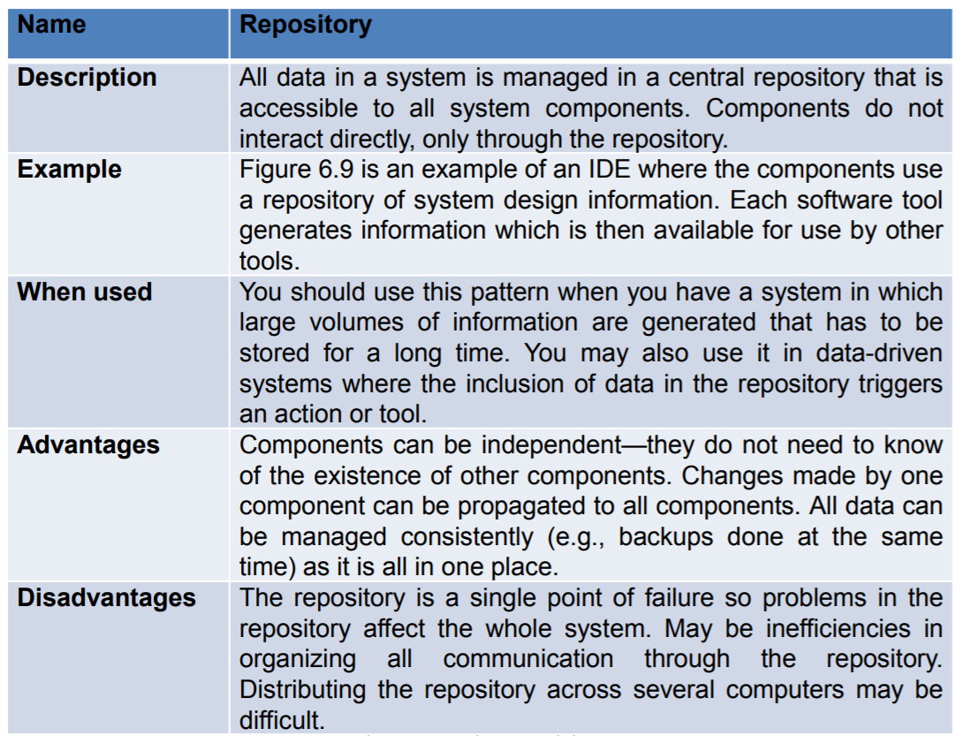
Repository Pattern

Slide 18
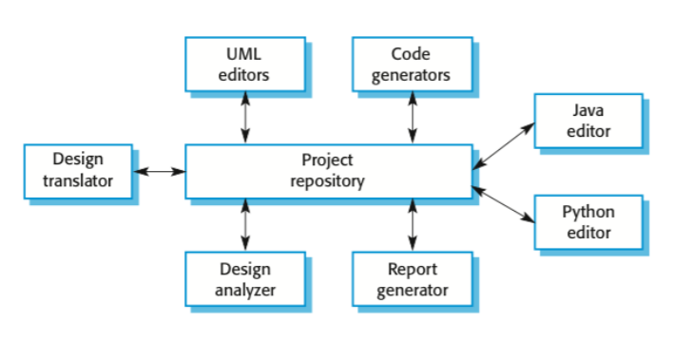
Repository Architecture

Slide 19
Advantages and Disadvantages
Advantages:
Efficient way to share large amounts of data
Sub-systems need not be concerned with how data is produced Centralised management e.g. backup, security, etc.
Sharing model is published as the repository schema
Disadvantages:
Sub-systems must agree on a repository data model
Data evolution is difficult and expensive
No scope for specific management policies
Difficult to distribute efficiently

Slide 20
Client Server Model
Client/server software engineering blends conventional principles, concepts, and methods with elements of object-oriented and component-based software engineering.
C/S architectures dominate the landscape of computer-based systems. In C/S architectures, software residing on one computer (the client) requests services or data from another computer (the server).
The process model used in C/S software engineering is evolutionary beginning with requirements elicitation. Functionality is allocated to subsystems of components that are assigned to either the client or the server side of the C/S architecture.
Design focuses on integration of existing components and creation of new components. Implementation and testing must exercise both the client and server functionality within the context of the component integration standards and the C/S architecture.
C/S software engineering relies on the same SQA practices as other software engineering processes. Formal technical reviews are used to assess the quality of the analysis and design models.
Specialized reviews consider issues associated with component integration and middleware. Testing is used to uncover errors at the component, subsystem, client, and sever levels.

Slide 21
Representative Client/Server Systems
File servers (client requests selected records from a file, server transmits records to client over the network)
Database servers (client sends SQL requests to server, server processes the request and returns the results to the client over the network)
Transaction servers (client sends requests that invokes remote procedures on the server side, sever executes procedures invoked and returns the results to the client)
Groupware servers (server provides set of applications that enable communication among clients using text, images, bulletin boards, video, etc.)

Slide 22
Software Components for C/S Systems
User interaction/presentation subsystem (handles all user events)
Application subsystem (implements requires defined by the application within the context of the operating environment, components may reside on either the client or server side)
Database management subsystem (performs data manipulation and management for the application)
Middleware (all software components that exist on both the client and the server to allow exchange of information)

Slide 23
Representative C/S configuration Options
Distributed presentation - database and application logic remain on the server, client software is used to reformat server data into GUI format
Remote presentation - similar to distributed presentation, primary database and application logic remain on the server, data sent by the server is used by the client to prepare the user presentation
Distributed logic - client is assigned all user presentation tasks associated with data entry and formulating server queries, server is assigned data management tasks and updates information based on user actions
Remote data management - applications on server side create new data sources, applications on client side process the new data returned by the server
Distributed databases - data is spread across multiple clients and servers, requiring clients to support data management as well as application and GUI components
Fat server - most software functions for C/S system are allocated to the server
Thin clients - network computer approach relegating all application processing to a fat server

Slide 24
Design Issues for C/S systems
Data and architectural design - dominates the design process to be able to effectively use the capabilities of RDBMS or OODMBS
Event-driven paradigm - when used, behavioral modeling should be conducted and the control-oriented aspects of the behavioral model should translated into the design model
Interface design - elevated in importance, since the user interaction/presentation component implements all functions typically associated with a GUI
Object-oriented point of view - often chosen, since an object structure is provides by events initiated in the GUI and their event handlers within the client-based software

Slide 25
Architectural Design for Client/Server Systems
Best described as communicating processes style architecture whose goal is to achieve easy scalability when adding and arbitrary number of clients
Since modern C/S systems tend to be component-based, an object request broker (ORB) architecture is used for implementation
Object adapters or wrappers provide service to facilitate communication among client and server components
component implementations are registered
all component references are interpreted and reconciled
component references are mapped to corresponding component implementations
objects are activated and deactivated
operations are invoked when messages are transmitted
security features are implemented

Slide 26
Layered Model
The most common architecture pattern is the layered architecture pattern, otherwise known as the n-tier architecture pattern.
This pattern is the de facto standard for most Java EE applications and therefore is widely known by most architects, designers, and developers.
The layered architecture pattern closely matches the traditional IT communication and organizational structures found in most companies, making it a natural choice for most business application development efforts.
Components within the layered architecture pattern are organized into horizontal layers, each layer performing a specific role within the application.

Slide 27
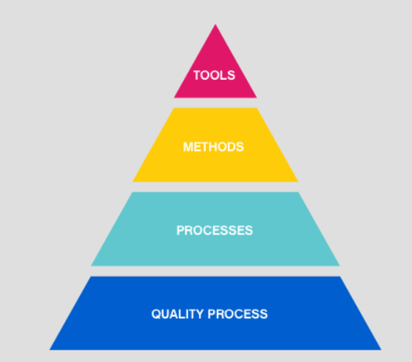
Continued....

Slide 28
Continued....
Tools: This layer contains automated or semi-automated tools that offer support for the framework and the method each software engineering project will follow.
Method: This layer contains the methods, the technical knowledge and “how-tos” in order to develop software.
Process: This layer consists of the framework that must be established for the effective delivery of software.
A Quality Focus: This layer is the fundamental layer for software engineering. As stated above it is of great importance to test the end product to see if it meets its specifications. Efficiency, usability, maintenance and reusability are some of the requirements that need to be met by new software.

Slide 29
Modular Decomposition
Styles of decomposing sub-systems into modules.
No rigid distinction between system organisation and modular decomposition.
A sub-system is a system in its own right whose operation is independent of the services provided by other sub-systems.
A module is a system component that provides services to other components but would not normally be considered as a separate system.
Another structural level where sub-systems are decomposed into modules.
Two modular decomposition models covered
An object model where the system is decomposed into interacting object;
A pipeline or data-flow model where the system is decomposed into functional modules which transform inputs to outputs.
If possible, decisions about concurrency should be delayed until modules are implemented.

Slide 30
Modular Decomposition (Object Model)
Structure the system into a set of loosely coupled objects with well-defined interfaces.
Object-oriented decomposition is concerned with identifying object classes, their attributes and operations.
When implemented, objects are created from these classes and some control model used to coordinate object operations.
Advantages:
Objects are loosely coupled so their implementation can be modified without affecting other objects.
The objects may reflect real-world entities.
OO implementation languages are widely used.
However, object interface changes may cause problems and complex entities may be hard to represent as objects.

Slide 31
Function-Oriented Pipelining
Functional transformations process their inputs to produce outputs.
May be referred to as a pipe and filter model (as in UNIX shell).
Variants of this approach are very common. When transformations are sequential, this is a batch sequential model which is extensively used in data processing systems.
Not really suitable for interactive systems.
Advantages:
Supports transformation reuse.
Intuitive organisation for stakeholder communication.
Easy to add new transformations.
Relatively simple to implement as either a concurrent or sequential system.
However, requires a common format for data transfer along the pipeline and difficult to support event-based interaction.

Slide 32
Procedural Design
A design methodology combines a systematic set of rules for creating a program design with diagramming tools needed to represent it.
Procedural design is best used to model programs that have an obvious flow of data from input to output. It represents the architecture of a program as a set of interacting processes that pass data from one to another.
Design Tools
The two major diagramming tools used in procedural design are data flow diagrams and structure charts.
Data Flow Diagrams
A data flow diagram (or DFD) is a tool to help you discover and document the program’s major processes. The following table shows the symbols used and what each represents.
The DFD is a conceptual model – it doesn’t represent the computer program, it represents what the program must accomplish. By showing the input and output of each major task, it shows how data must move through and be transformed by the program.

Slide 33
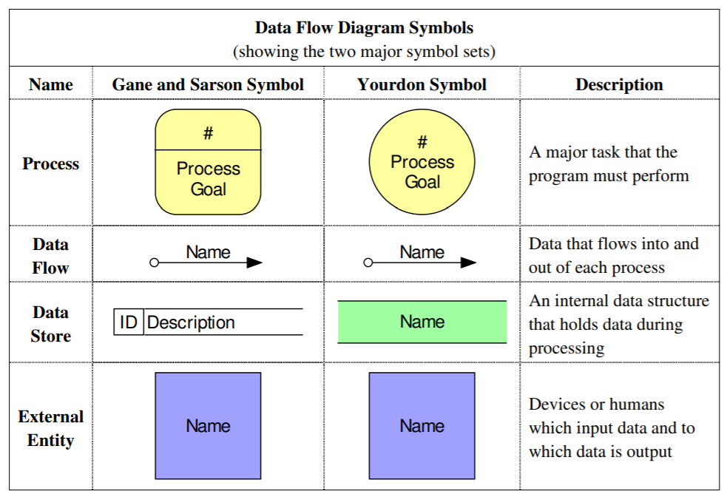
Continued....

Slide 34
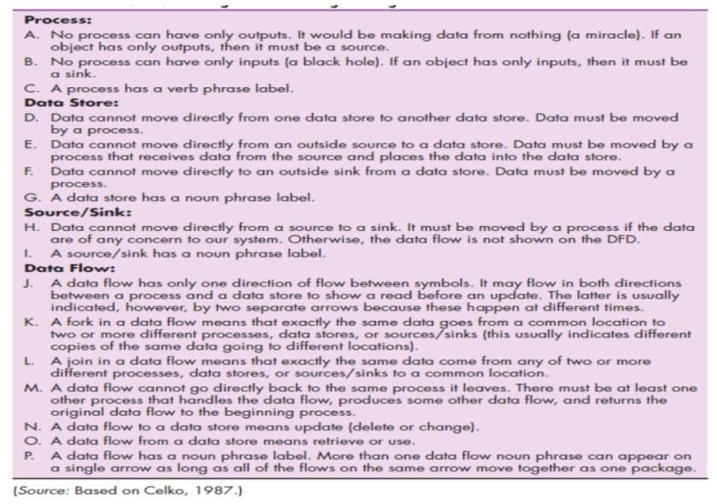
Data Flow Model Rules

Slide 35
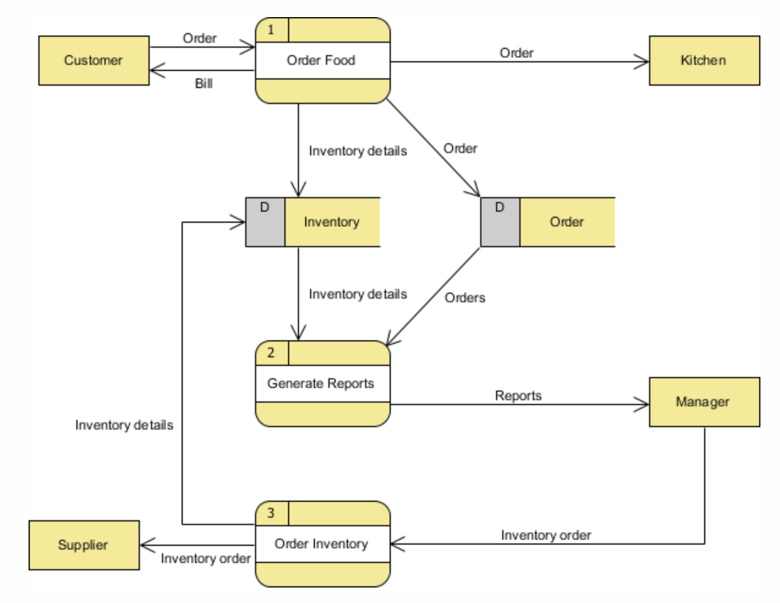
Example (Food Ordering System)

